Slide 1

Docker Compose App in the Cloud
Greta Piliponytė, Jana Karas, Jördis Krieger

Slide 2
Contents
Starting point
GitHub Actions
Terraform & AWS
Solution 1
Solution 2
Working Demo

Slide 3
Basic Idea and Tools

Slide 4




Starting Point
Docker-based web application for managing apartments
Consists of several containers
Apartments
docker-compose.yml
Reserve
Search

Slide 5
Basic Idea
Create EC2 machine
EC2 machine
Push
Create Infrastructure with Terraform
Deploy app with docker compose

Slide 6
Github Actions
Create EC2 machine
EC2 machine
Push
Create Infrastructure with Terraform
Deploy app with docker compose

Slide 7
GitHub Actions
Platform for continuous integration and continuous delivery (CI/CD)
Trigger workflow to deploy our app in the cloud automatically
Push
GitHub Action
Print „Hello World“

Slide 8
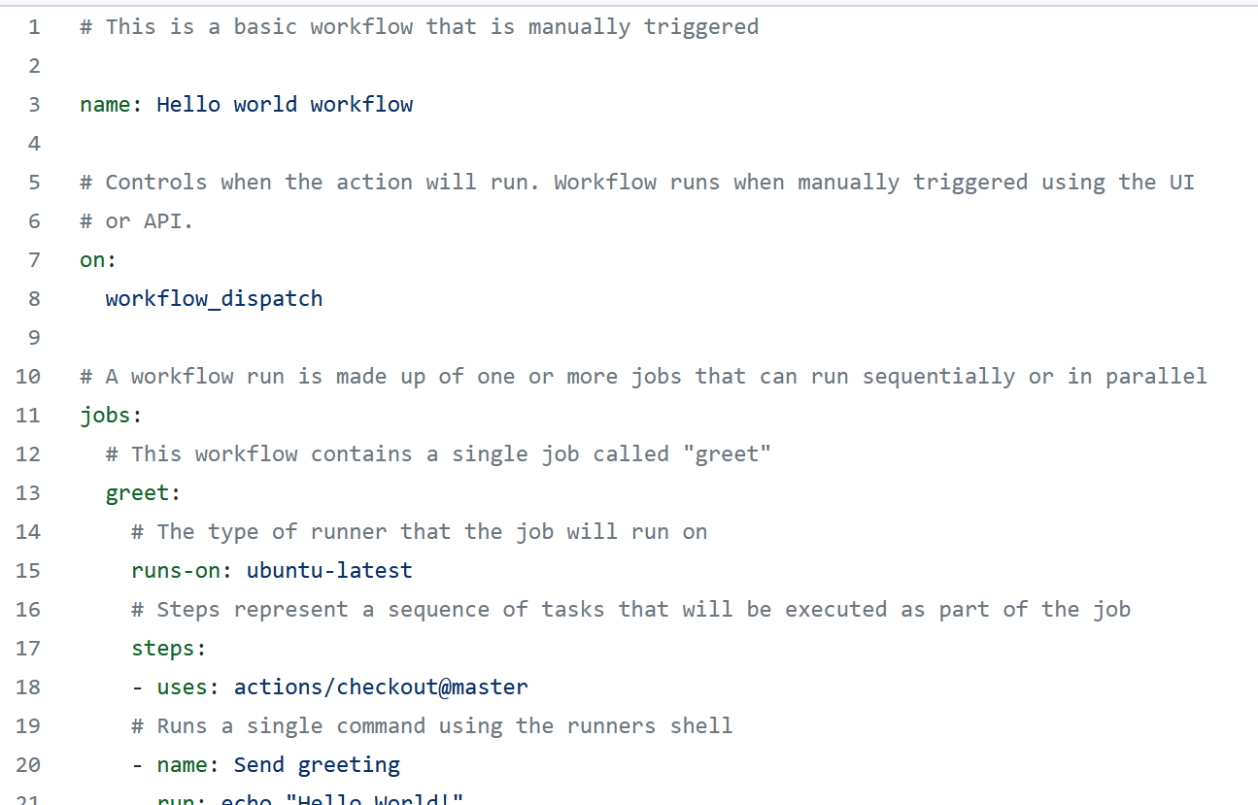
hello_world.yml

Slide 9
Terraform
Create EC2 machine
EC2 machine
Push
Create Infrastructure with Terraform
Deploy app with docker compose

Slide 10
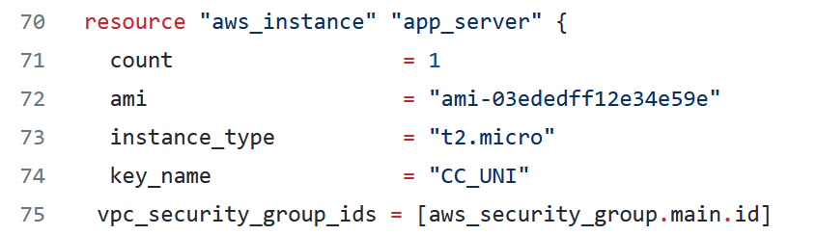
Terraform
Terraform to automatically build, change, and version public cloud infrastructure

Slide 11
AWS
Create EC2 machine
EC2 machine
Push
Create Infrastructure with Terraform
Deploy app with docker compose

Slide 12
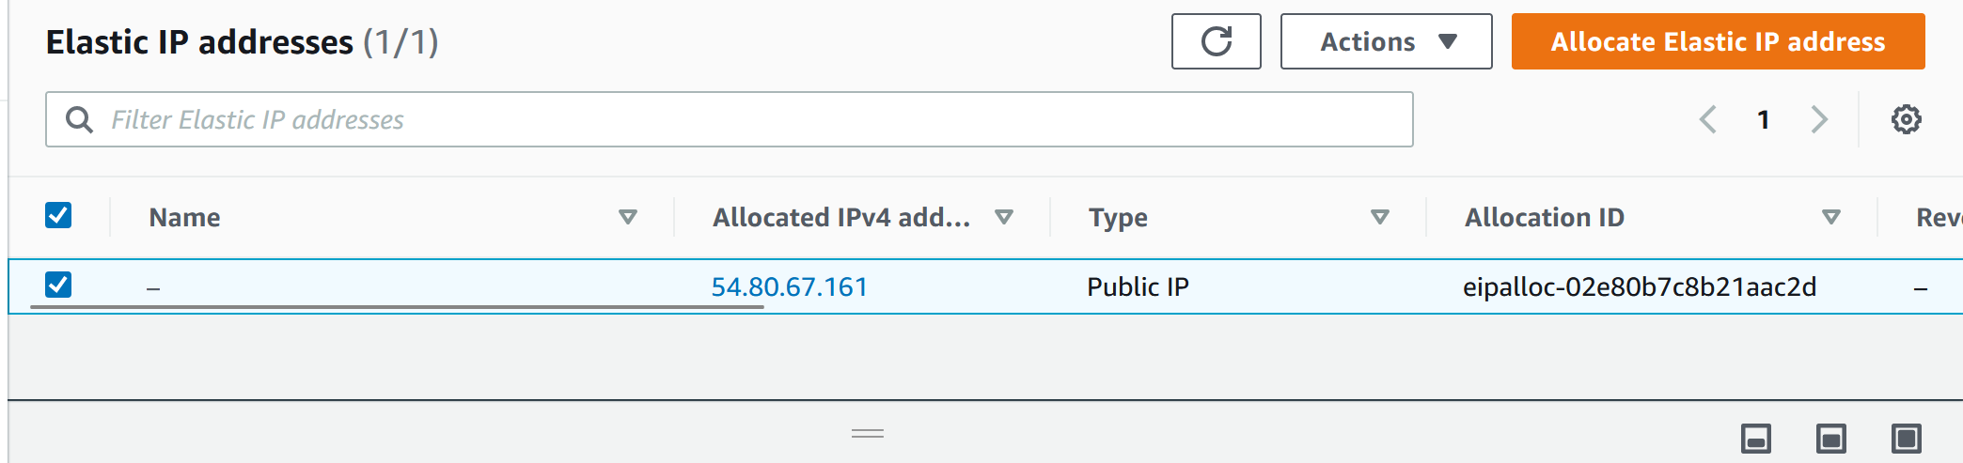
AWS
Amazon Elastic Compute Cloud (EC2) to deploy our application
Security groups
Elastic IP

Slide 13
Solution

Slide 14
Critical Points
Create EC2 machine
EC2 machine
Push
Create Infrastructure with Terraform
Deploy app with docker compose

Slide 15
Critical Points
Create EC2 machine
EC2 machine
Push
Create Infrastructure with Terraform
Deploy app with docker compose

Slide 16
Critical Points
Create EC2 machine
EC2 machine
Push
Create Infrastructure with Terraform
Push docker images to dockerhub
Deploy app with docker compose

Slide 17
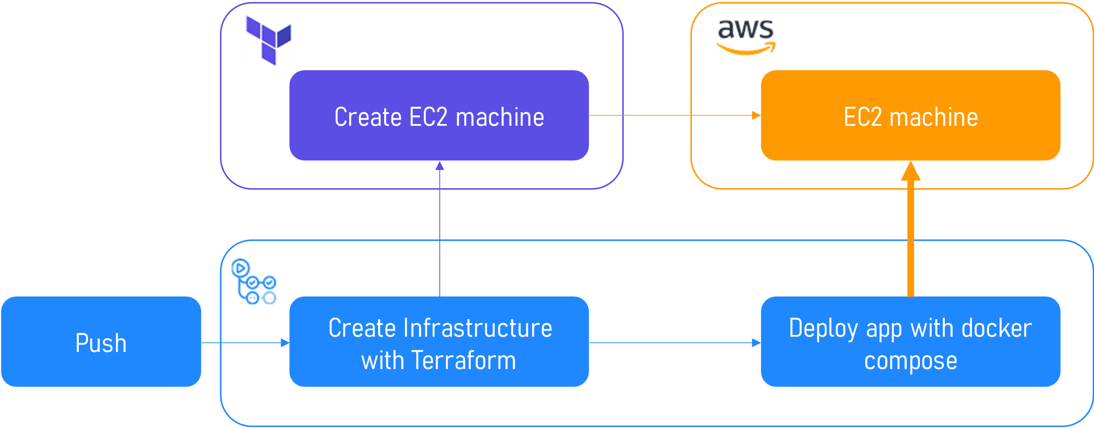
Critical Points
How can we…
…install docker & docker-compose in the EC2?
…put our containers in the EC2?
…start the application via docker-compose up?

Slide 18


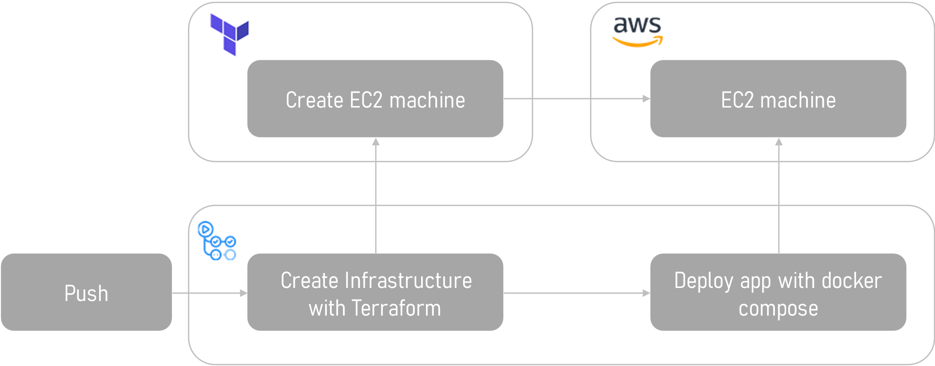

Solution 1
1) Install docker & docker-compose in user_data
3) Upload app via github .zip-Link and docker-compose up
2) SSH into EC2

Slide 19
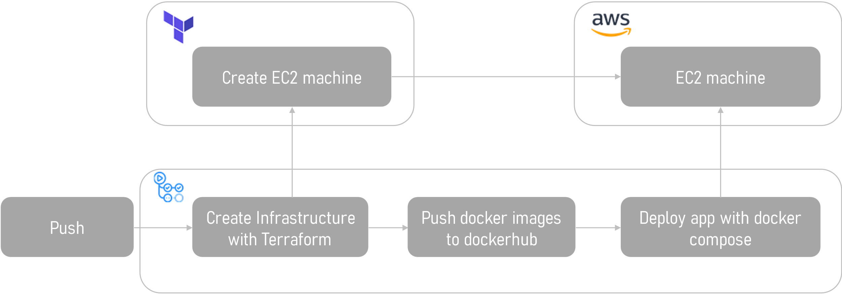
Solution 2
3) Upload composefile and database files with scp, and do docker-compose up with dockerhub-images
1) Install docker & docker-compose in user_data
2) SSH into EC2

Slide 20
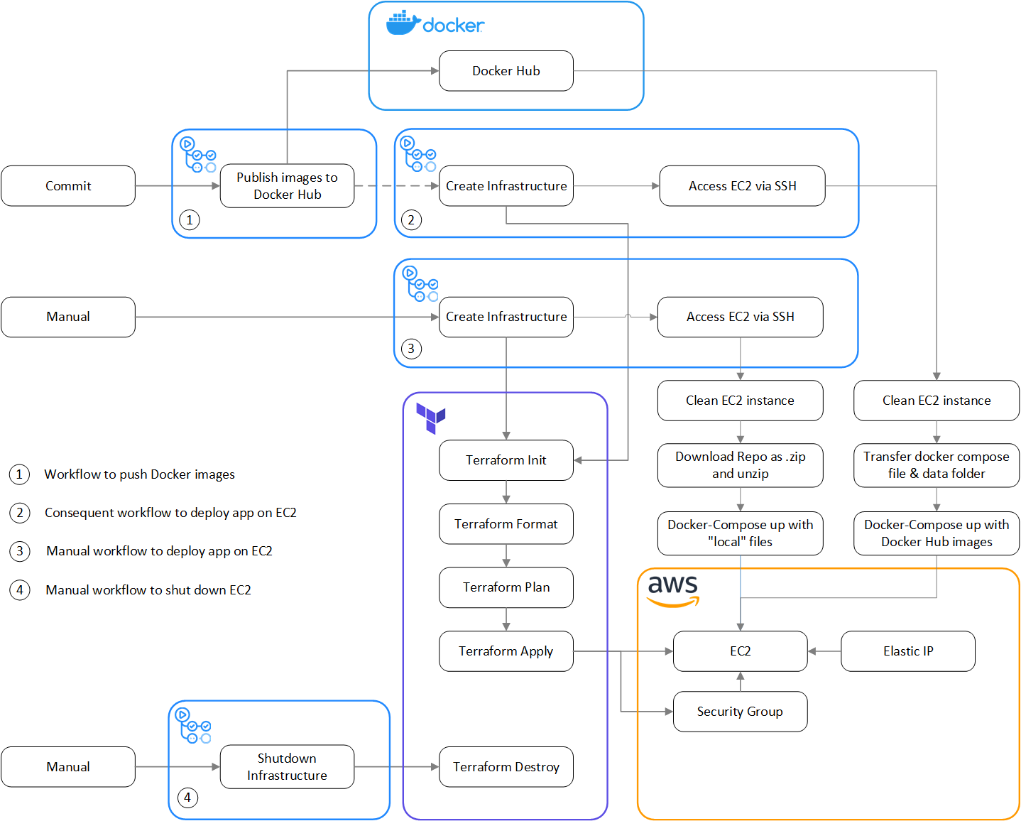

Slide 22
Solution 1
Deployment via .zip link:
1) Installation of Docker and Docker Compose SSH to access EC2 instance
Installation of Docker and Docker Compose on EC2
Upload of application via .zip link from GitHub Repo to EC2
Docker-compose up on EC2

Slide 23
Solution 2
Deployment via DockerHub:
1. workflow
Push images to DockerHub
2. workflow:
SSH to access EC2 instance
Installation of Docker and Docker Compose on EC2
Loading of images from DockerHub to EC2
Docker-compose up on EC2 with docker-compose.dockerhub.yml

Slide 24
Working Demo
See the magic…

